Slide 1

Course-Project-Presentation: 02.03.2018
Topic:
„Finding Dynamic DeadWrites“
Subject: Program Testing and Analysis WS 2017 / 2018
Nicolas Voigt (1289808)
Kai-Nico Nase(2644914)

Slide 2
Definition: What are DeadWrites?
In general, DeadWrites can be called source code elements(e.g. single or multiple statements),
which have no real use during the execution of a e.g. Java-Application and are therefore
superfluous.
  They can be disadvantageous and impair performance (e.g. execution speed).
  The simplest types of DeadWrites are simply declaring variables(e.g. var x;) that are never used again afterwards
  or assigning variables such as x=1; followed by y=x;. In the latter case, the value "1" is written from x to y => y=1; but y then is no longer used in a subsequent process.
  Static means "Write a value to a variable, but, this value is never read again afterwards
  Dynamic means "Write over Write", respectively, "Write" -> "No Read!!!" -> "Write".
Notes:
Test1
Test2

Slide 3
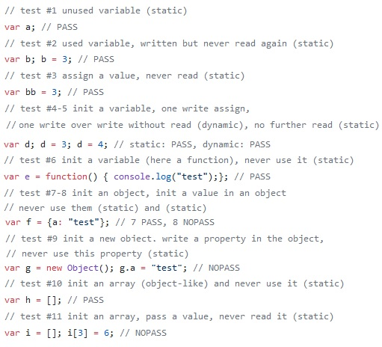
11 Static sampels and 1 dynamic sample of DeadWrites are stand among each other in one File called„Level1.js“ :

Slide 4
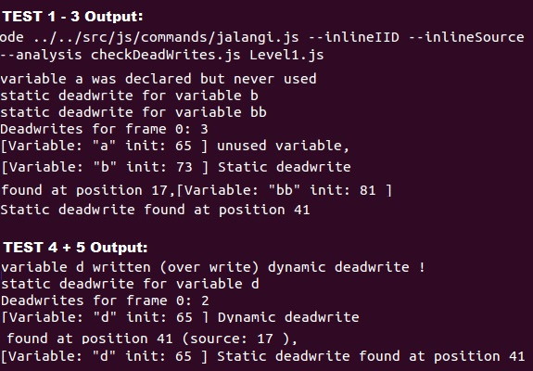
Output of the analyzed javascript-samples 1-3 and 4+5 (privous slide – File: Level1.js) peformed by our Jalangi-Code-Analysis:
The shellcommand to start our J.C.-Analysis is the following:
"Root-Directory"/src/js/commands/jalangi.js _x0015_inlineIID _x0015_ inlineSource _x0015_analysis ./checkDeadWrites.js Level1.js

Slide 5
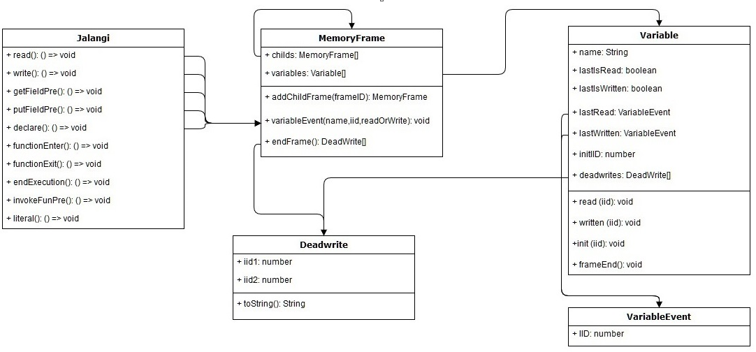
Overall-Architecture of Components and Workflow („Jalangi-Code-Analysis“)

Slide 6
Additional Points – Results / Answers:
  Given a JavaScript program, the output of the project will be the program without the dead writes?
  Parse each program using esprima to generate an AST. Traverse the AST using estraverse and delete the identify dead writes.
  For the _x001c_nal evaluation, use the JavaScript libraries Backbone, Backbone LayoutManager,BigNumber, Bootstrap Datepicker, Cal-Heatmap, Countdown, Underscore. These libraries have available tests. Run your analysis while executing these tests
  Remove the dead writes and run the tests again to see if any of them fail.
  Overall, what percentage of writes are dead?
  What is the difference in size (bytes) of the program after removing the dead writes?
  Is there any noticeable performance improvements after removing the dead writes?
Notes:
Test1
Test2

Slide 7
Thank you for your attention!

